Slide 1
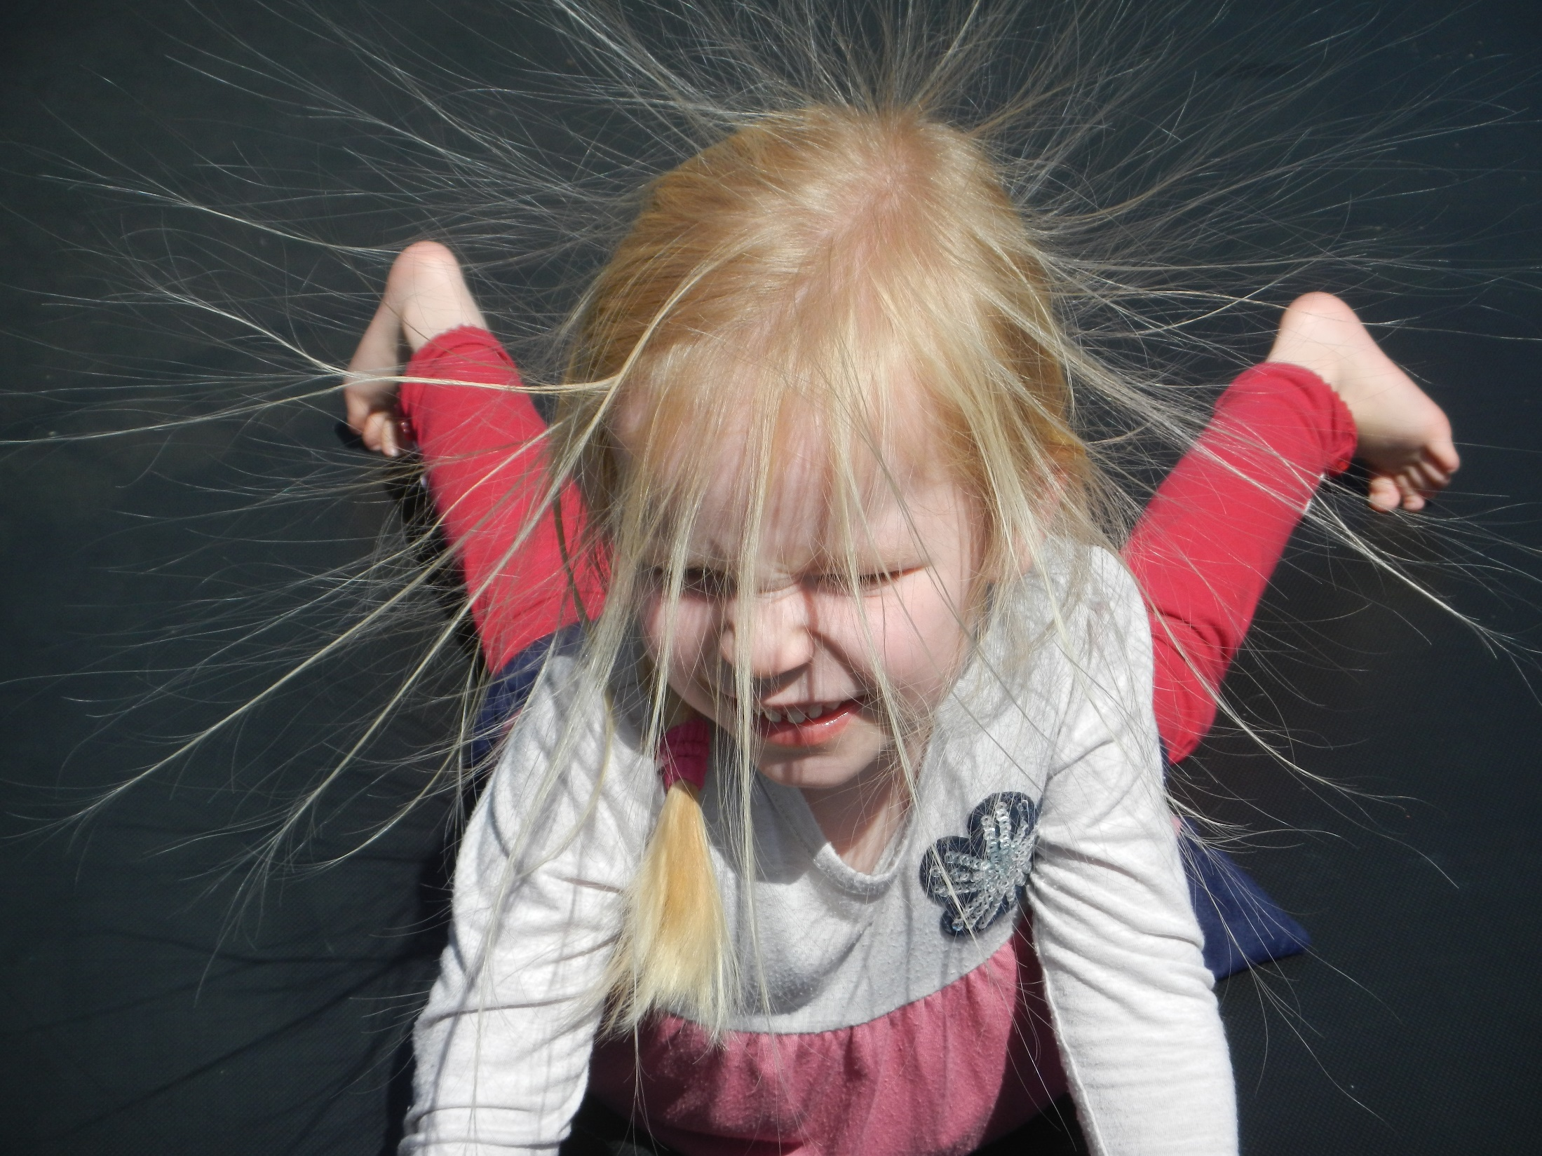
Uniform Electric Fields
4.1 and 4.2 Electric Fields and Coulombs Law

Slide 2
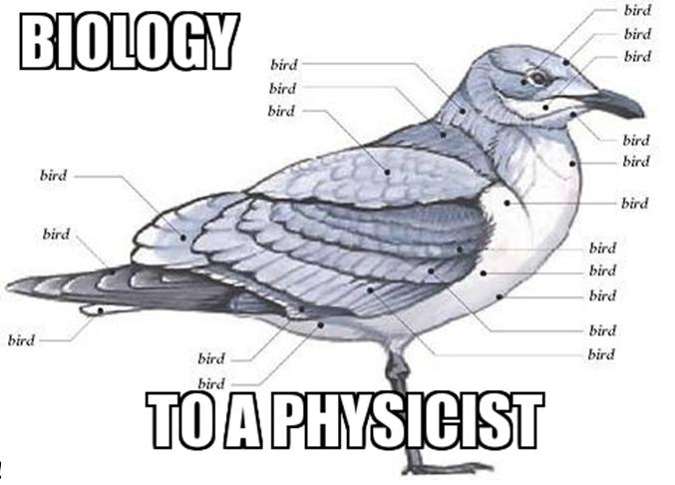
Electric Force and Electric field
What should we already know?
Notes:
Re-cap of stuff from IGCSE that they should already know.

Slide 3
Electric Force and Electric field
1. There are two types of electric charge (positive and negative)

Slide 4
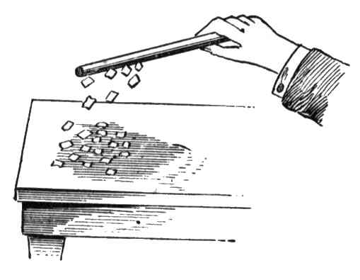
Electric Force and Electric field
2. Static charges can be produced by the action of friction on an insulator

Slide 5
Electric force and electric field
3. Conductors contain many free electrons inside them (electrons not associated with one particular atom)

Slide 6
Electric Force and Electric field
4. Charge is conserved. The total charge of an isolated system cannot change.
I’m indestructible!
So am I!

Slide 7
Electric Force and Electric field
5. Opposite charges attract, like charges repel.
I’m strangely attracted to you!
Are you sure?
I’m positive.

Slide 8
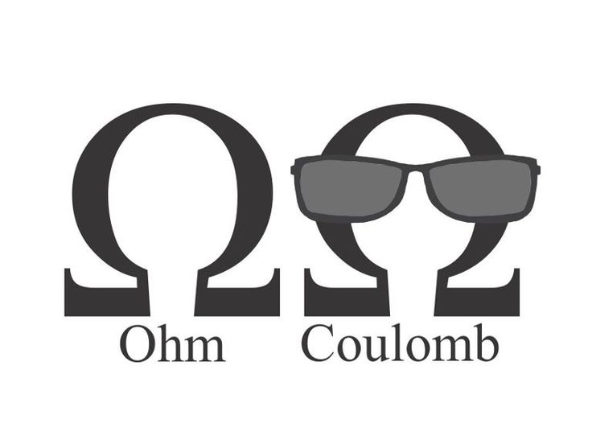
What is the difference between an ohm and a coulomb?
This is an Ohm
(it’s a unit of Resistance)
And this is a Coulomb
(it’s a unit of Charge)

Slide 9
Fundamental unit of charge
The electron
e = - 1.60 x 10⁻¹⁹ C
Protons therefore have the same charge but are positive.
Charge is important where directions of current or forces need to be determined.

Slide 10
Electric Field Strength
Gravitational fields are concerned with masses, whereas electric fields are concerned with charges. An electric field exists in a region of space in which a stationary charge experiences a force.
Electric charges create an electric field in the space around them. Unlike gravitational forces, which are always attractive, electric forces can be attractive or repulsive.
The electric field strength E at a point is the force experienced per unit positive charge on a point charge placed at that point.
E = F
q

Slide 11
Electric Field Strength
Where F is the electric force experienced by a particle of charge +q. Like force, electric field strength is a vector. Rearranging this equation gives
F = Eq
Electric field (E) strength has units N C⁻¹.
Gravitational field strength had units N kg⁻¹

Slide 12
Problems
NOTE - Charge of electron = -1.60 x 10⁻¹⁹ C
Where the field strength is 1000 NC⁻¹, what is the force on a 1 C charge? On an electron?
F = Eq = 1000 x 1 = 1000 N
F = Eq = 1000 x 1.6 x 10⁻¹⁹ = 1.6 x 10⁻¹⁶ N
A charged sphere is placed in a field of strength 3.00 x 10⁴ N C⁻¹. If it experiences a force of 15.0 N, what is the charge on the sphere?
q = F/E = 15.0 /(3.00 x 10⁴) = 5.00 x 10⁻⁴ C
3. What is the field strength if an electron experiences a force of 4.80 x 10⁻¹⁴ N?
E = F/q = 4.80 x 10⁻¹⁴ / (1.60 x 10⁻¹⁹) = 3.00 x 10⁵ N C⁻¹

Slide 13
Electric Field Strength Between Charged Parallel Plates
For a given separation and P.D (voltage), the electric field strength between two parallel plates is constant (uniform) except at the edges.
A point charge q is moved between the plates and experiences a constant force F due to the uniform electric field.
Work done on the charge. (Change in Energy)
W = Fd (force x distance /displacement moved
→ Year 11 Motion)
From Year 11 studies in Electricity we know that work done on a charge (energy transformed) can also be shown as:
W = qV (the potential through which the charge moves).
+ + + + + + ++ + + + + + + +
E = V/d
-
-
-
-
-
-
-
-
-
-
-
+q
d

Slide 14
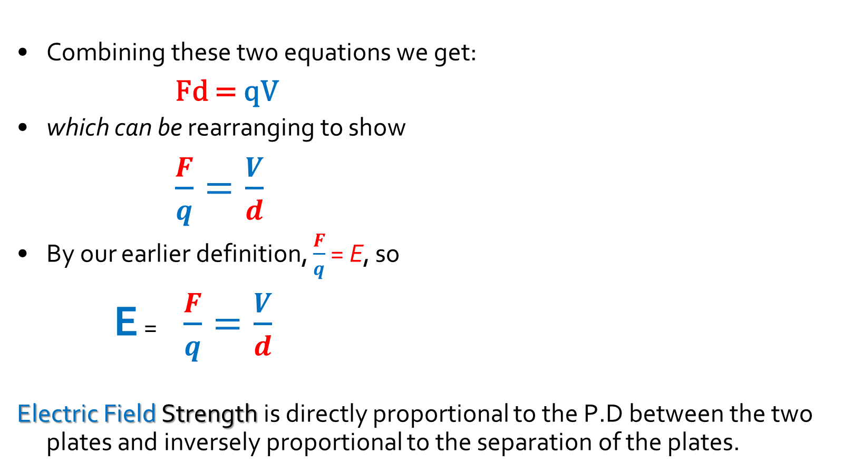
Electric Field Strength Between Charged Parallel Plates
Combining these two equations we get:
Fd = qV
which can be rearranging to show
$\frac{F}{q}=\frac{V}{d}$
By our earlier definition, $\frac{F}{q}$ = E, so
E = $\frac{F}{q}=\frac{V}{d}$
Electric Field Strength is directly proportional to the P.D between the two plates and inversely proportional to the separation of the plates.
+ + + + + + ++ + + + + + + +
E = V/d
-
-
-
-
-
-
-
-
-
-
-
+q
d

Slide 15
Worked Example
A charged dust particle is stationary between two horizontal charged metal plates. The metal plates have a separation of 3.6 cm and the P.D between the plates is
720 V. The dust particle has a charge of +7e, where e = 1.6 x 10⁻¹⁹ C. Calculate:
The electric field strength between the plates
E = V / d = 720 / 0.036 = 2.0 x 10⁴ V m⁻¹
The weight of the dust particle
The particle is stationary, therefore the net force must be zero.
Weight = Electric force = Eq = 2.0 x 10⁴ x (7 x 1.6 x 10⁻¹⁹) = 2.2 x 10⁻¹⁴ N

Slide 16
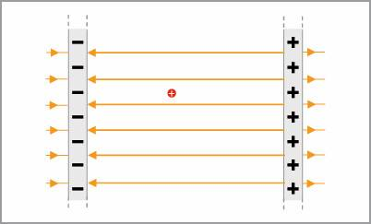
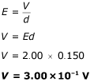
More Examples
A particle of charge 30.0 μC is immersed in an electric field of strength 2.00 N C⁻¹ between two charged parallel plates. The negative plate has a potential of -1.00 x 10⁻¹ V. If the positively charged plate is 15.0 cm from the negative plate calculate the magnitude of the electric potential at:
a) the positively charged plate
Therefore the positively charged plate has a potential of
-1.00 x 10⁻¹ V + 3.00 x 10⁻¹ V = 2.00 x 10⁻¹ V
b) any point halfway between the plates.
Therefore the middle point has a potential of
-1.00 x 10⁻¹ V + 1.50 x 10⁻¹ V (half of 0.3V P.D) = 0.50 x 10⁻¹ V
This is the potential difference, and not the final answer

Slide 17
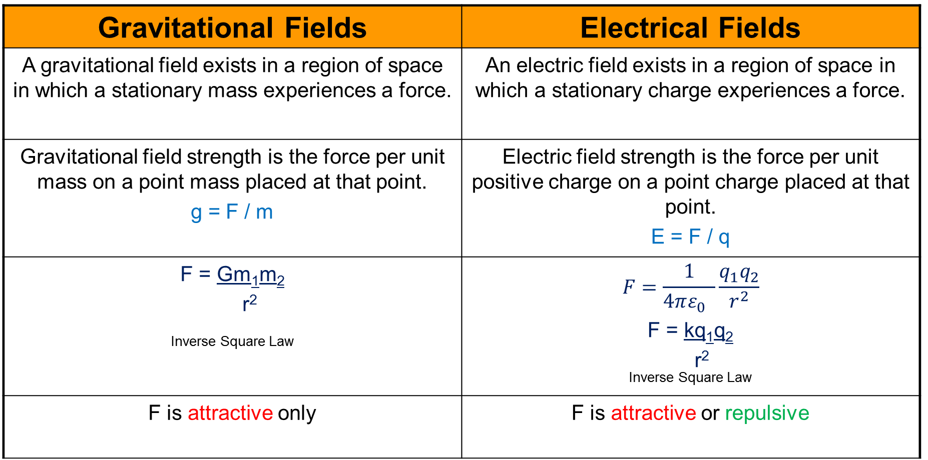
Gravitational vs Electric Fields
Gravitational Fields | Electrical Fields
A gravitational field exists in a region of space in which a stationary mass experiences a force. | An electric field exists in a region of space in which a stationary charge experiences a force.
Gravitational field strength is the force per unit mass on a point mass placed at that point. g = F / m | Electric field strength is the force per unit positive charge on a point charge placed at that point. E = F / q
F = Gm₁m₂ r² ^{Inverse Square Law} | $$F=\frac{1}{4πε_{0} }\frac{q_{1}q_{2}}{r^{2}}$$ F = kq₁q₂ r² ^{Inverse Square Law}
F is attractive only | F is attractive or repulsive

Slide 18
Electric Field patterns
An electric field can be represented by lines and arrows on a diagram , in a similar ways to magnetic field lines.
The arrows show the direction of force that would be felt by a positive charge in the field

Slide 19
Electric Field patterns
An electric field can be represented by lines and arrows on a diagram , in a similar ways to magnetic field lines.
The closer the lines are together, the stronger the force felt.
This is an example of a radial field

Slide 20
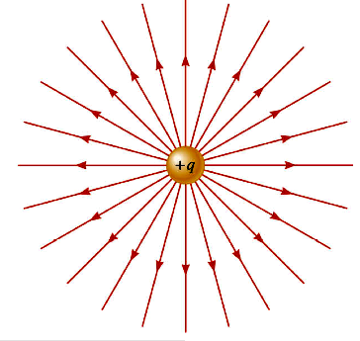
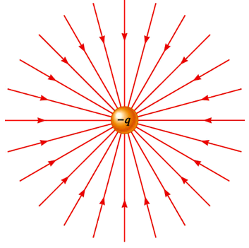
Electric Field patterns
radial for point charges
out for positive (begin)
in for negative (end)

Slide 21
Electric Field Patterns
Electric field patterns are visualised using electric field lines
Electric fields go from positively charged objects to negatively charged objects.
Electric field lines start and end at 90∘ to the surface, with no gap between the lines and the surface.
Field lines can never cross; if they did it would indicate that the field is in two directions at that point, which can never happen.
Around small charged spheres, called point charges, the field lines radiate like spokes on a wheel.
Around point charges you should draw eight field lines: top, bottom, left, right and another field line in between each of these.
The density of electric field lines (number) indicates the strength of the electric field. Closely spaced electric field lines indicates greater electric field strength.
Parallel and equally spaced electric field lines indicate an electric field of constant field strength (a uniform field).

Slide 22
Number of lines proportional to charge
2Q
Q

Slide 23
Begin and end only on charges; never cross
Force direction?

Slide 24
Electric field
An Electric field is a vector, and any calculations regarding fields (especially involving adding the fields from more than one charge) must use vector addition.
Field here due to both charges?
q₁
q₂

Slide 25
Electric field
An Electric field is a vector, and any calculations regarding fields (especially involving adding the fields from more than one charge) must use vector addition.
Field due to q₁
Field here due to both charges?
q₁
q₂

Slide 26
Electric field
An Electric field is a vector, and any calculations regarding fields (especially involving adding the fields from more than one charge) must use vector addition.
Field due to q₁
Field due to q₂
Field here due to both charges?
q₁
q₂

Slide 27
Electric field
An Electric field is a vector, and any calculations regarding fields (especially involving adding the fields from more than one charge) must use vector addition.
Field due to q₁
Field due to q₂
Resultant field
q₁
q₂

Slide 28
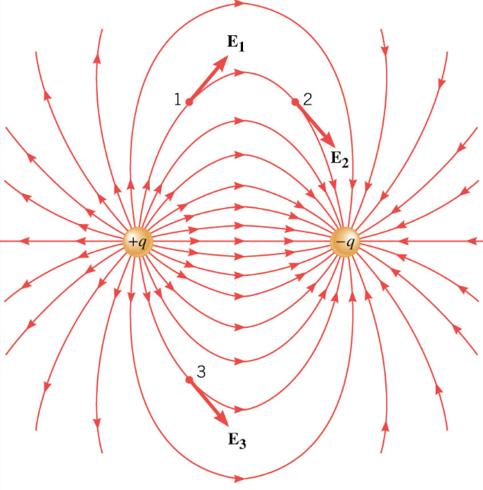
a) Dipole (opposite charges)

Slide 29
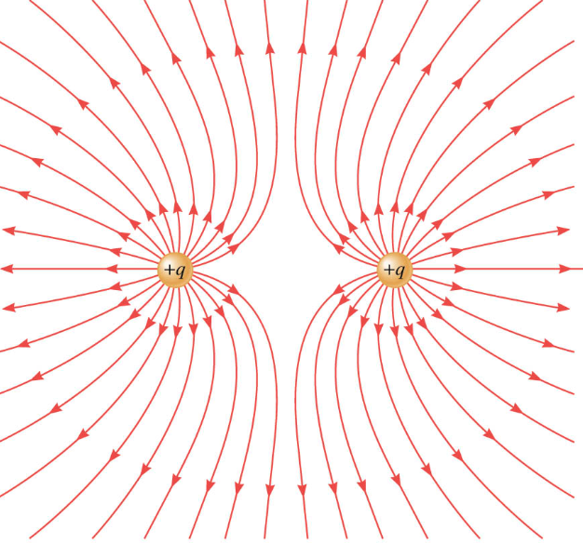
b) two positive charges

Slide 30


Neutral Point
The force exerted on a charge here would be exactly equal and opposite

Slide 31
Field between charged parallel plates
V
Uniform field E = V/d
d
“Edge effects”
Notes:
Not sure whther to include this or not – left in for safety!

Slide 32
Field between charged parallel plates
V
Notes:
Not sure whther to include this or not – left in for safety!

Slide 33
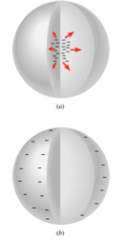
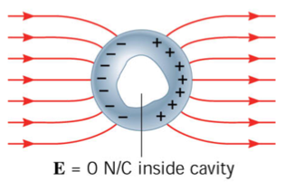
Electric Fields and Conductors
A conductor will distort an Electric Field
The field will cause movement of charge within the conductor due to the force effect.
Excess charge resides on surface at equilibrium
E₁
E₁
E₂

Slide 34
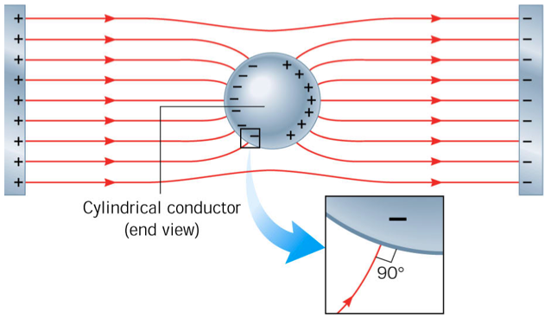
• Field lines perpendicular at surface

Slide 35
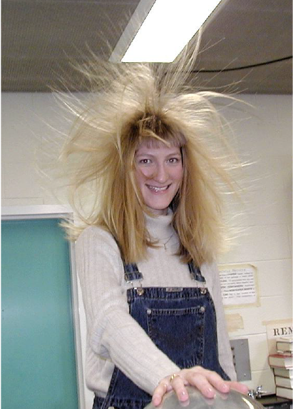

Slide 36
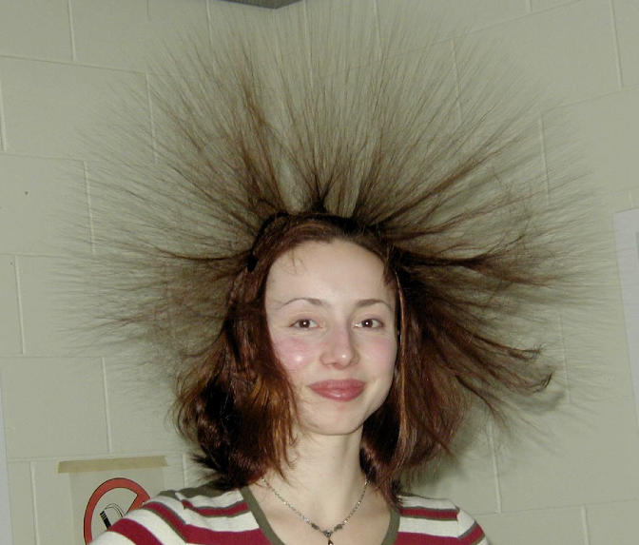

Slide 37
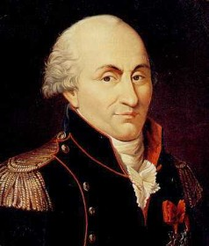
Electric Force and Coulomb’s Law
The force between two charges was investigated by Charles Augustin Coulomb in 1785

Slide 38
Electric Force and Coulomb’s Law
Coulomb found that the force between two point charges is proportional to the product of the two charges
F α q₁ x q₂
and inversely proportional to the square of the distance (r) between the charges
F α 1/r²

Slide 39
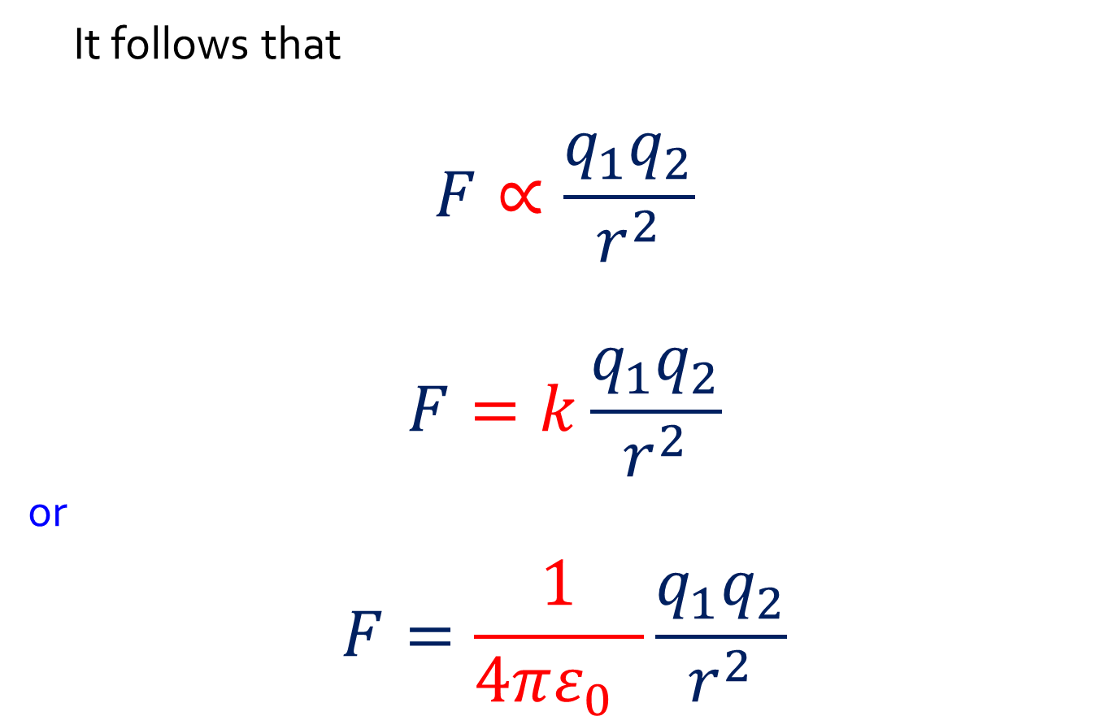
Electric Force and Coulomb’s Law
It follows that
$$F∝\frac{q_{1}q_{2}}{r^{2}}$$
$$F=k\frac{q_{1}q_{2}}{r^{2}}$$
^{or}
$$F=\frac{1}{4πε_{0} }\frac{q_{1}q_{2}}{r^{2}}$$

Slide 40
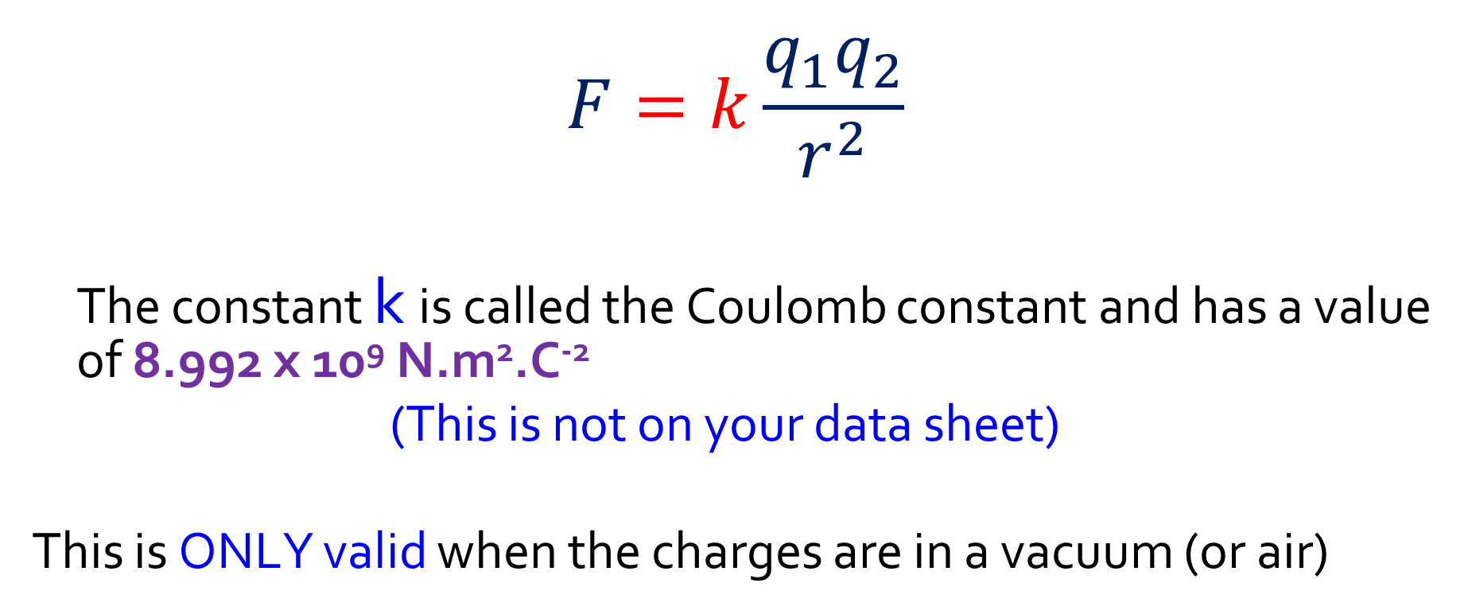
Electric Force and Coulomb’s Law
$$F=k\frac{q_{1}q_{2}}{r^{2}}$$
The constant k is called the Coulomb constant and has a value of 8.992 x 10⁹ N.m².C⁻²
(This is not on your data sheet)
This is ONLY valid when the charges are in a vacuum (or air)

Slide 41
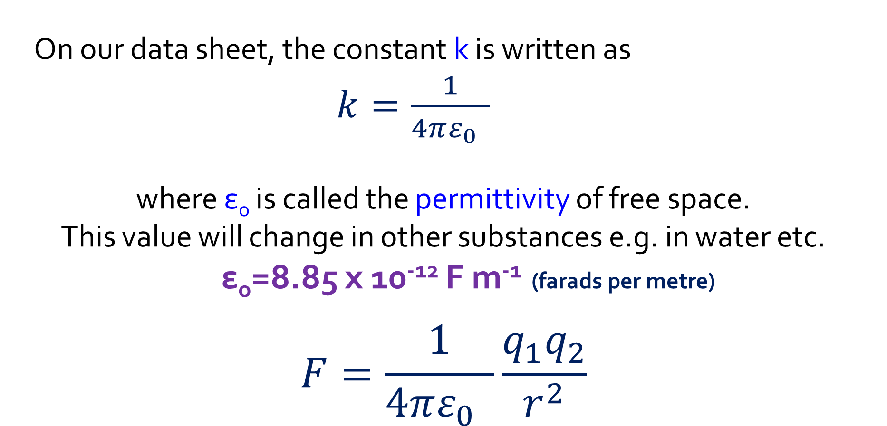
Coulomb’s law
On our data sheet, the constant k is written as
$k=\frac{1}{4πε_{0} }$
where ε_{o} is called the permittivity of free space.
This value will change in other substances e.g. in water etc.
ε_{o}=8.85 x 10⁻¹² F m⁻¹ (farads per metre)
$$F=\frac{1}{4πε_{0} }\frac{q_{1}q_{2}}{r^{2}}$$
Notes:
The syllabus strongly implies that attraction/repulsion in other media will be used in questions.

Slide 42
Calculations using Coulomb’s law
1.
What is the force between two electrons held one metre apart in a vacuum?
What is the gravitational force of attraction between them?
Compare the two values.

Slide 43
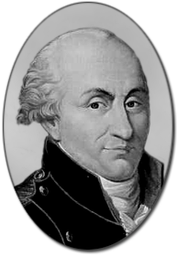
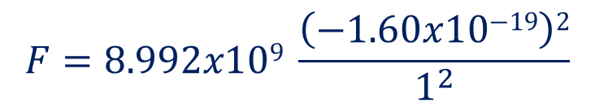
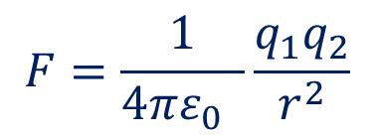
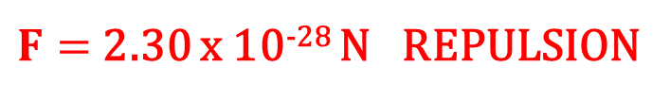
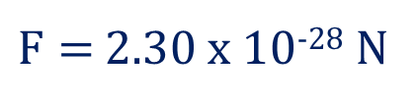
Calculations using Coulomb’s law
What is the force between two electrons held one metre apart in a vacuum?
What does the fact that this answer is positive tell us?
$$F=\frac{1}{4πε_{0} }\frac{q_{1}q_{2}}{r^{2}}$$
$$F=8.992x109 \frac{\left(−1.60x10\text{−19}\right)2}{1^{2}}$$
$F=$ 2.30 x 10⁻²⁸ N
$F=$ 2.30 x 10⁻²⁸ N REPULSION

Slide 44
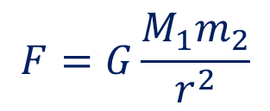
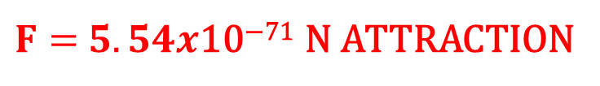
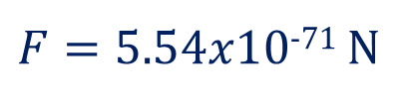
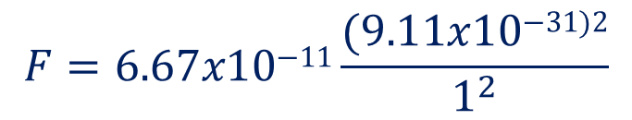
Calculations using Coulomb’s law
What is the gravitational force of attraction between them?
$$F=G\frac{M_{1}m_{2}}{r^{2}}$$
Direction?
$$F=6.67x\text{10}\text{−11}\frac{(9.11x\text{10}\text{−31}\text{)2}}{1^{2}}$$
$F=5.54x\text{10}\text{−71}$ N
$F=$ $5.54x\text{10}\text{−71}$ N ATTRACTION

Slide 45
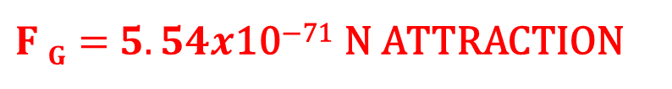
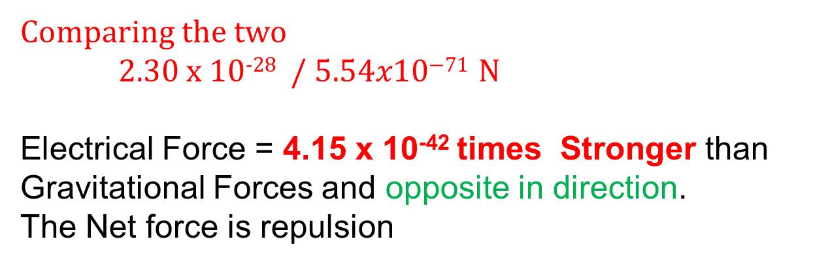
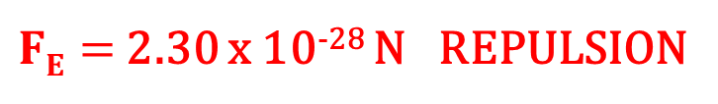
Calculations using Coulomb’s law
Compare the two values.
$FE=$ 2.30 x 10⁻²⁸ N REPULSION
Wow! Gravity is pathetic compared to the power of the Electric Force!
$F G=$ $5.54x\text{10}\text{−71}$ N ATTRACTION
Comparing the two
2.30 x 10⁻²⁸ / $5.54x\text{10}\text{−71}$ N
Electrical Force = 4.15 x 10⁻⁴² times Stronger than Gravitational Forces and opposite in direction.
The Net force is repulsion

Slide 46
Calculations using Coulomb’s law
The force between two charges is 20.0 N. If one charge is doubled, the other charge tripled, and the distance between them is halved, what is the resultant force between them?
q₁
q₂
F = 20N
r
2q₁
3q₂
F = ? N
r/2

Slide 47
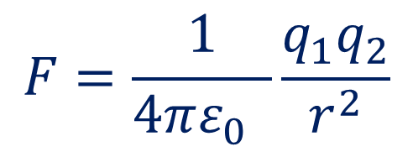
Calculations using Coulomb’s law
$$F=\frac{1}{4πε_{0} }\frac{q_{1}q_{2}}{r^{2}}$$
Look at the Equation.
What does doubling one charge do to the Force if everything else is constant?
F = doubled also
q₁
q₂
F = 20N
r
2q₁
3q₂
F = ? N
r/2

Slide 48
Calculations using Coulomb’s law
$$F=\frac{1}{4πε_{0} }\frac{q_{1}q_{2}}{r^{2}}$$
Look at the Equation.
What does doubling one charge and tripling the other do to the Force if everything else is constant?
F = x 2 x 3 = 6 times bigger
q₁
q₂
F = 20N
r
2q₁
3q₂
F = ? N
r/2

Slide 49
Calculations using Coulomb’s law
$$F=\frac{1}{4πε_{0} }\frac{q_{1}q_{2}}{r^{2}}$$
Look at the Equation.
What does halving the radius do to the Force if everything else is constant?
F = 1/0.5² x = 4 times bigger
q₁
q₂
F = 20N
r
2q₁
3q₂
F = ? N
r/2

Slide 50
Calculations using Coulomb’s law
$$F=\frac{1}{4πε_{0} }\frac{q_{1}q_{2}}{r^{2}}$$
Combining these….
Changing charges increases by 6 times and then changes to radius increase by 4 times so overall…
F = 6 x 4= 24 times bigger !
24 x 20 N = 480N
q₁
q₂
F = 20N
r
2q₁
3q₂
F = ? N
r/2

